Slide 1
User Testing with Prototypes
Group: STUDYING (aka “Team Procrastination”)
Sandra Song
Marcos Chen
Donovan O.A.Toure
Sriya Sarkar

Slide 2
Hypothesis 1
If students are shown an easy way to breakdown and manage their assignments then they will be more engaged and less likely to procrastinate.

Slide 3
Hypothesis 2
Creative-based students are more willing to use this solution more than non-creatives.

Slide 4
User test candidates
Computer science students
IDM students
Students we interviewed before

Slide 5
Prototype test
Process breakdown
Breakdown + Time management
Finding a studying space
Psychological priming through gamification

Slide 6
Testing Method
Explain the whole idea
Ask some background questions
Do the testers using digital calendar to keep/manage their schedule?
Observation
Demo prototypes through task-based interaction

Slide 7
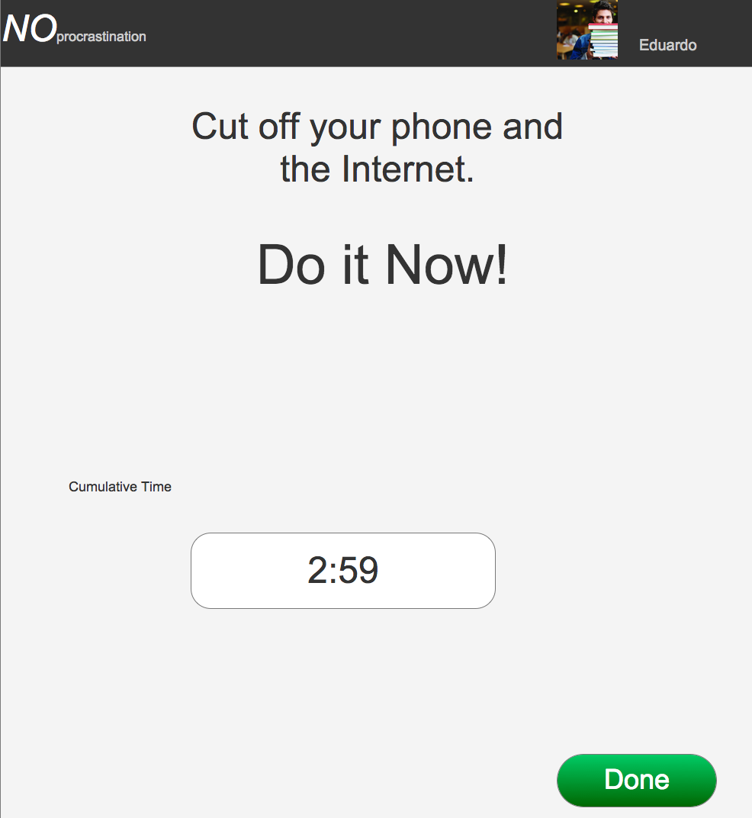
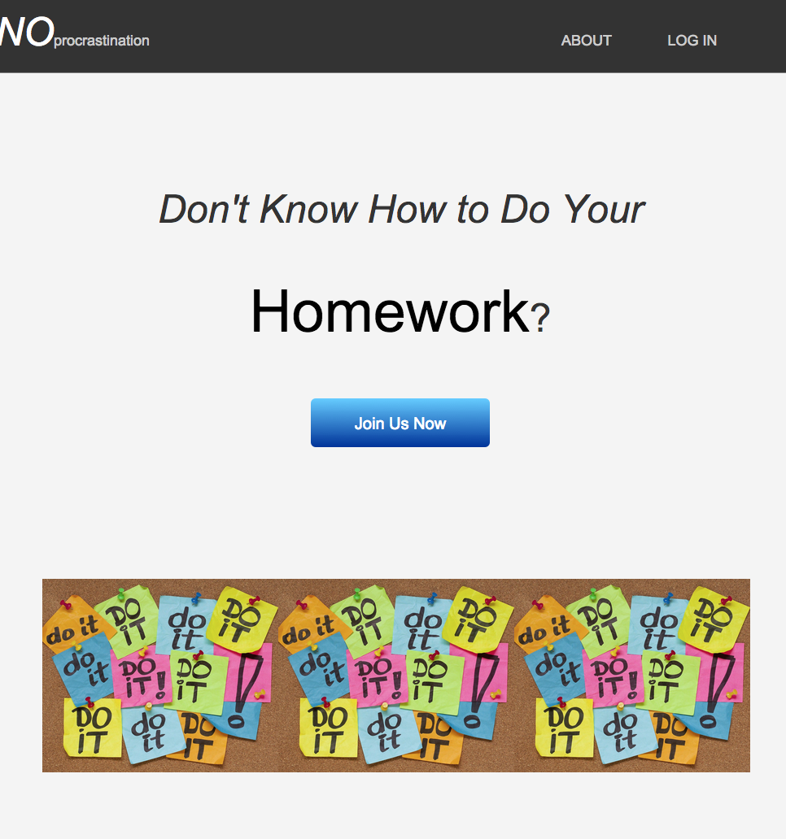
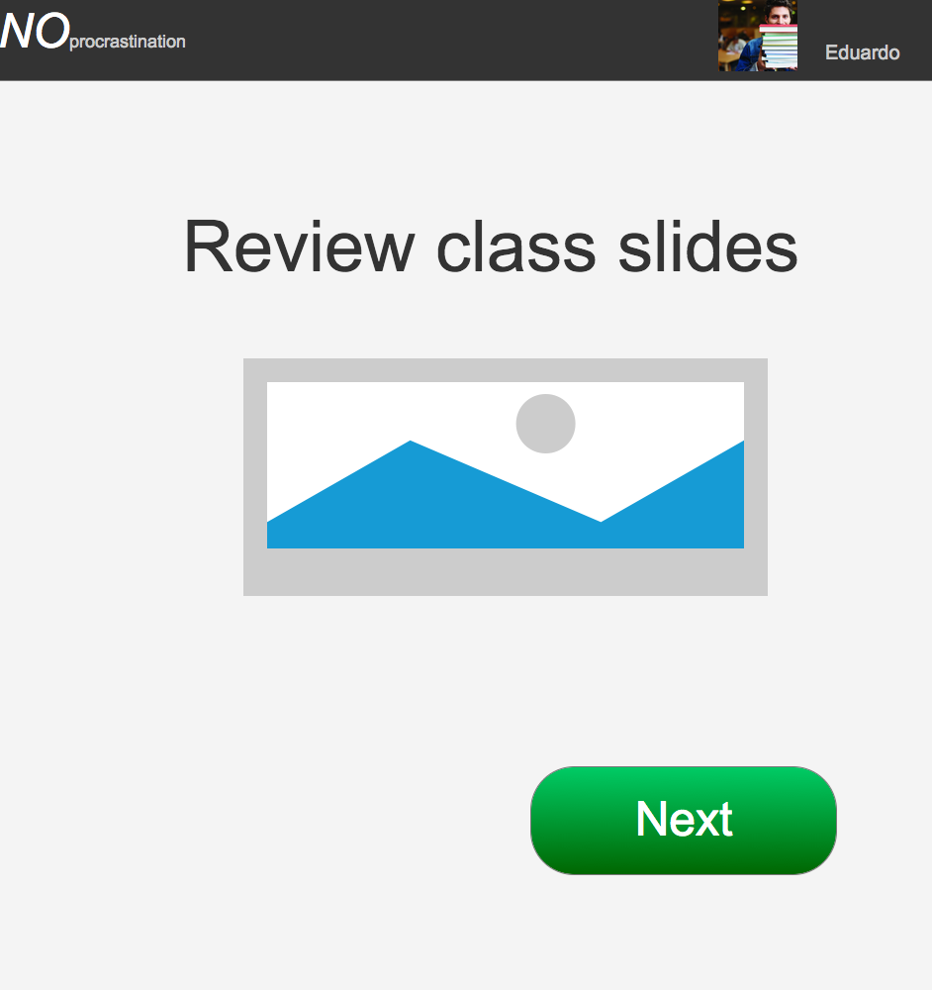
Sandra’s Prototype

Slide 8
Test Findings
Simple and easy to follow; very intuitive
The steps don’t seem necessary or suited for assignments

Slide 9
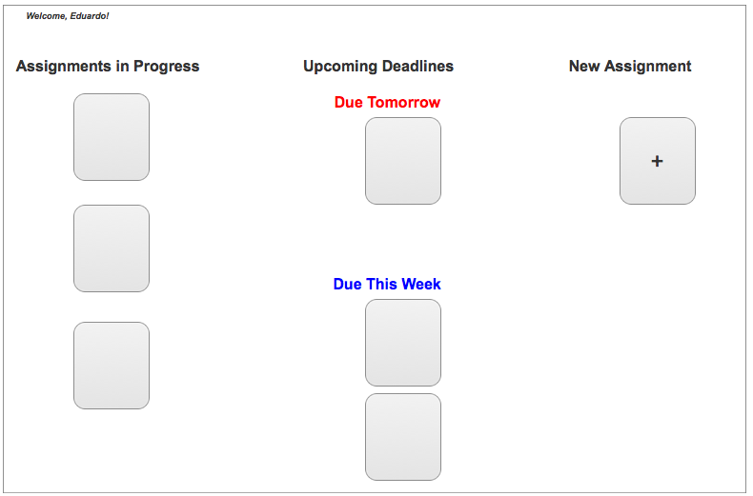
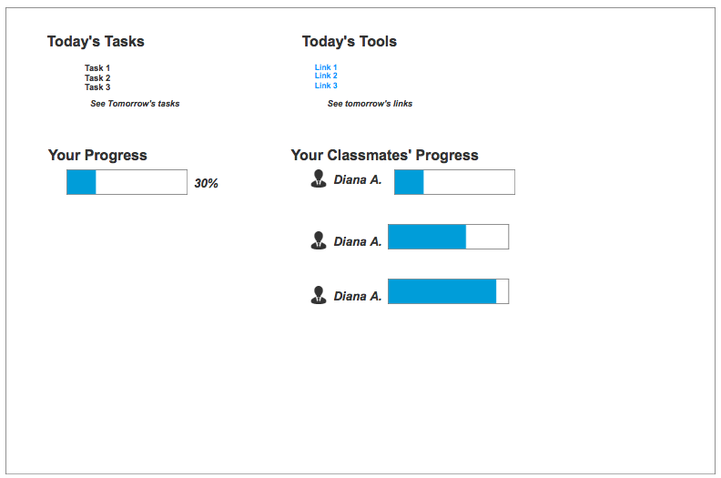
Sriya’s Prototype

Slide 10
Test Findings
Scheduling is the right direction to go in
The breakdown feature probably won’t be helpful in the long run
By creating so much work before users can even start their work is a turnoff to users and defeats the purpose

Slide 11
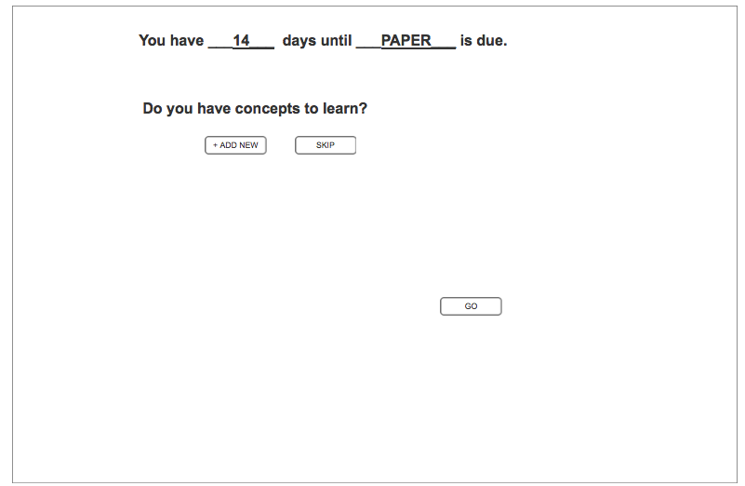
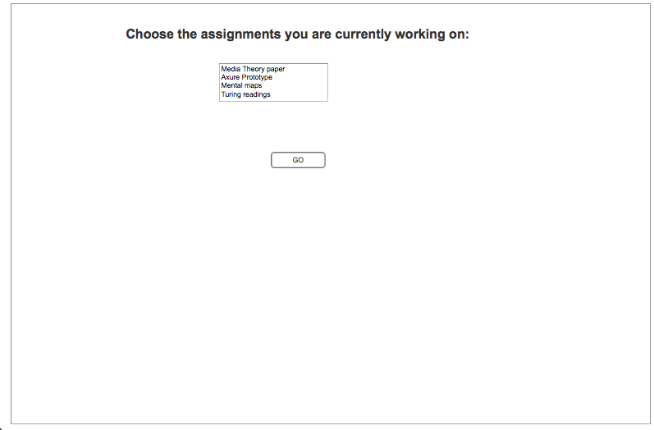
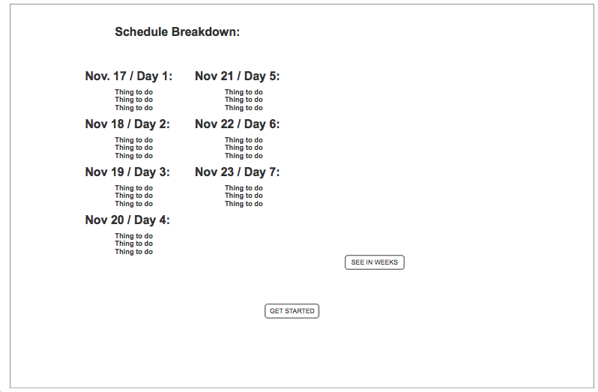
Sriya’s Prototype

Slide 12
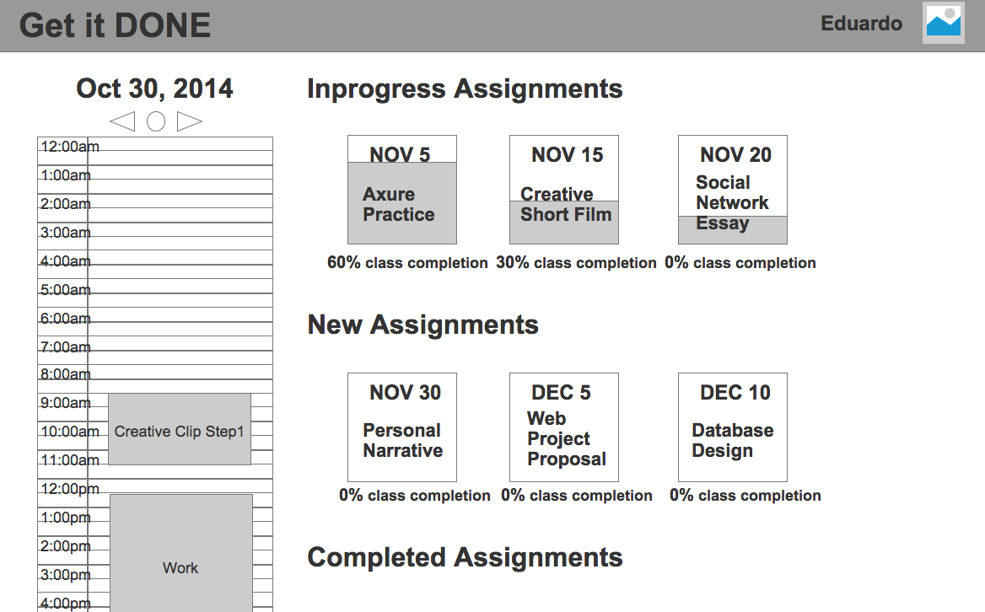
Marcos’ Prototype

Slide 13
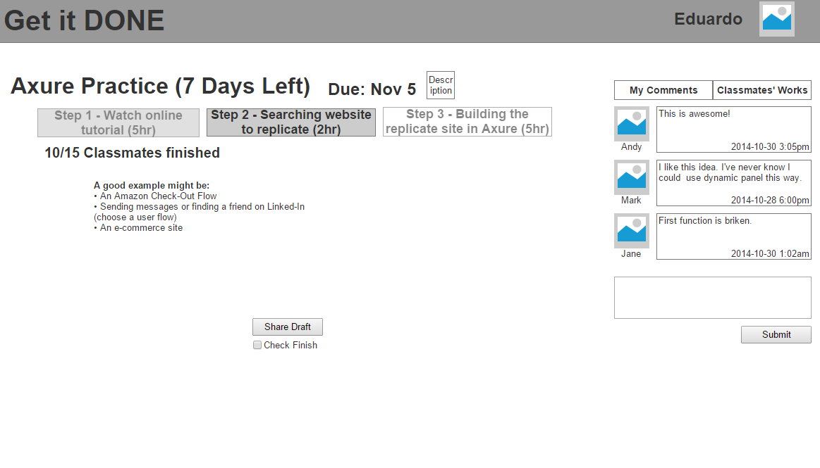

Slide 14
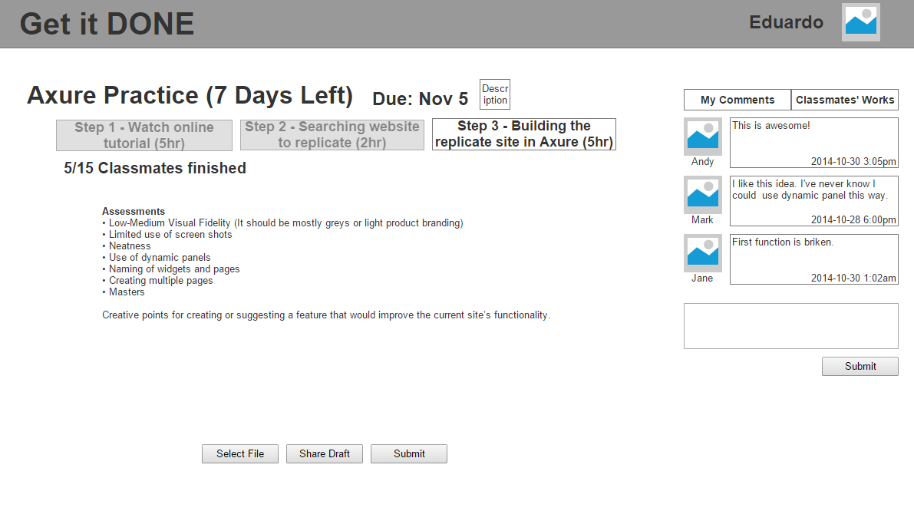
Confusing Part

Slide 15
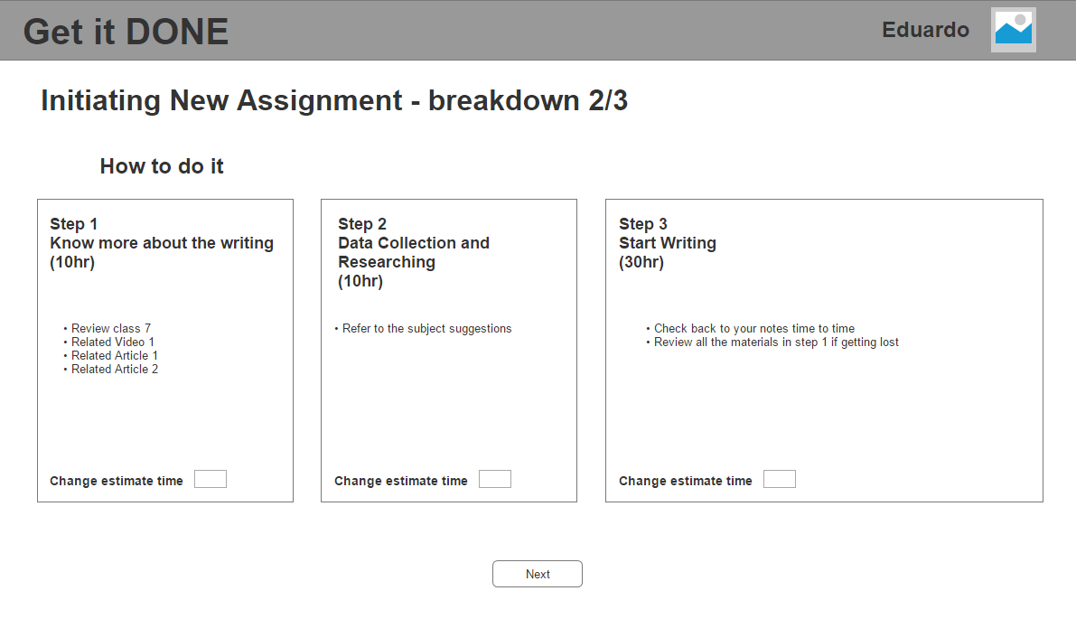

Slide 16
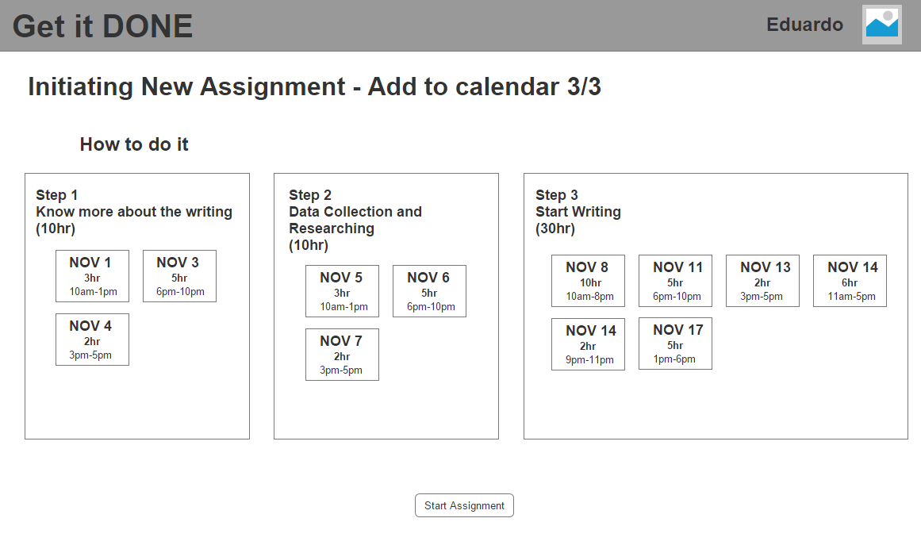

Slide 17
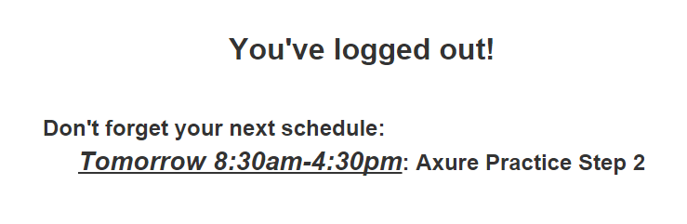

Slide 18
Test Findings
The prototype is lack of a flow
Most functions are useful
overall class progress, slide calendar
Most CS students think breaking down is one of learning process and is a critical skill
People do sometimes get stuck and don’t know how to get started
The solution doesn’t help people who don’t use electronic tool to help managing their schedule
Don’t have reschedule function

Slide 19
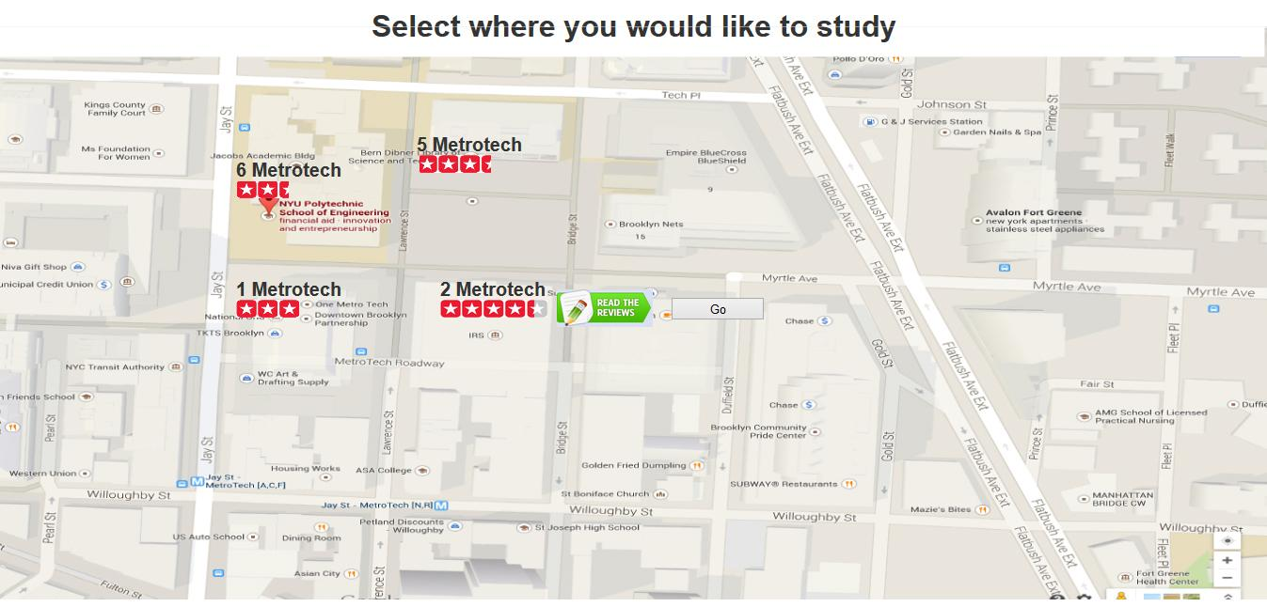

Slide 20
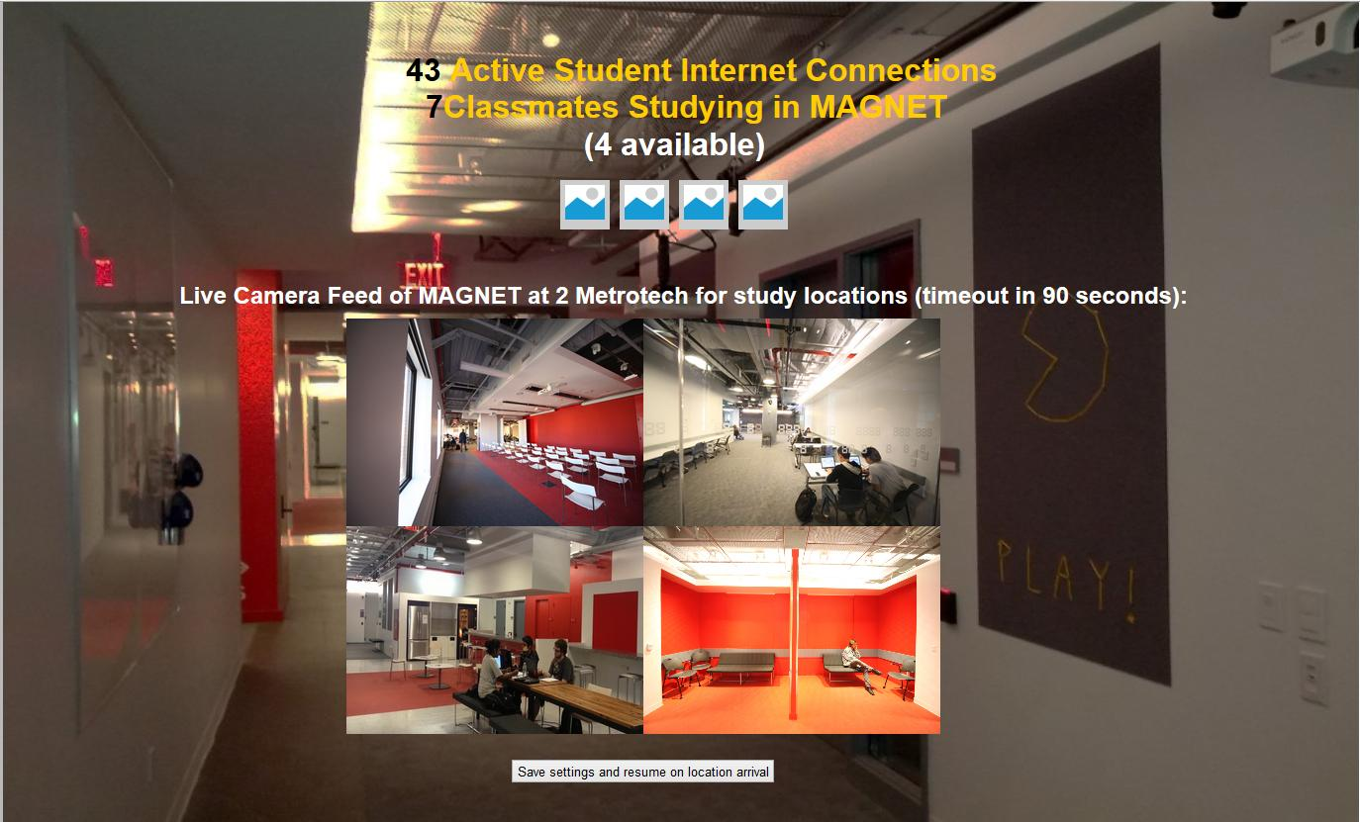
Donovan’s Prototype

Slide 21
Test Findings
Review systems may not be useful after students discover where they like to study (such as after the first three weeks of class)
Some would use the reviews to find a study based on what/where isn’t popular
Camera/location discovery system would be perfect during “crunch time”
The location discovery tool can be condensed into one dynamic screen/panel
Some users are concerned about the login process and metadata

Slide 22
Results Summary
People prefer to schedule their assignments themselves instead of letting software help them
Study tools are seen more as a distraction than an aid - the effort needed to use them might as well go towards doing the actual work
Better suited to managing learning, rather than managing assignments

Slide 23
What’s Next?
Back to the drawing board - our hypotheses and assumptions were disproved-ish
We need to reevaluate our approach to solving this problem
Luckily, we got some valuable input from our users regarding ways forward

